Slide 1
Artificial Intelligence in Banking
।। जय श्री राम।।

Slide 2

Introduction applications in banking Loan Processing Risk Management Customer Service Security fraud DETECTION Conclusion

Slide 3

Introduction
Artificial intelligence (AI) is revolutionizing the way we do business, and banking is no exception. With the help of AI, banks can streamline their operations, improve customer service, and even detect fraud more effectively.

Slide 4
LOAN PROCESSING
RISK MANAGEMENT
CUSTOMER SERVICE
SECURITY
FRAUD DETECTION

Slide 5
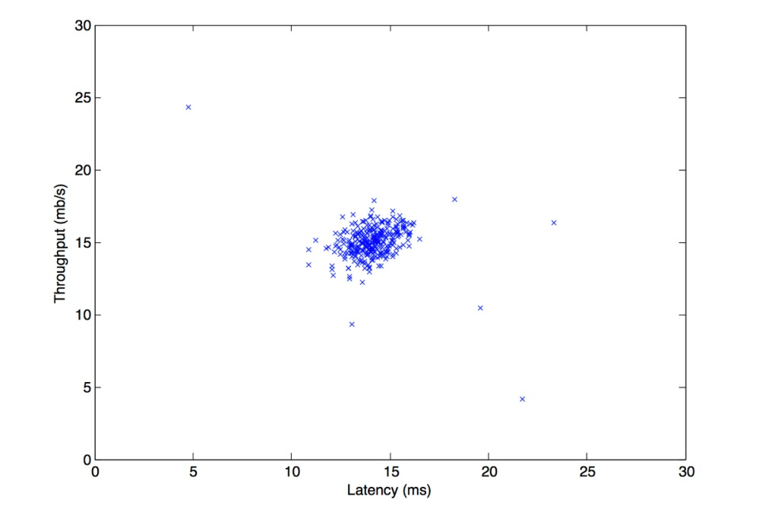
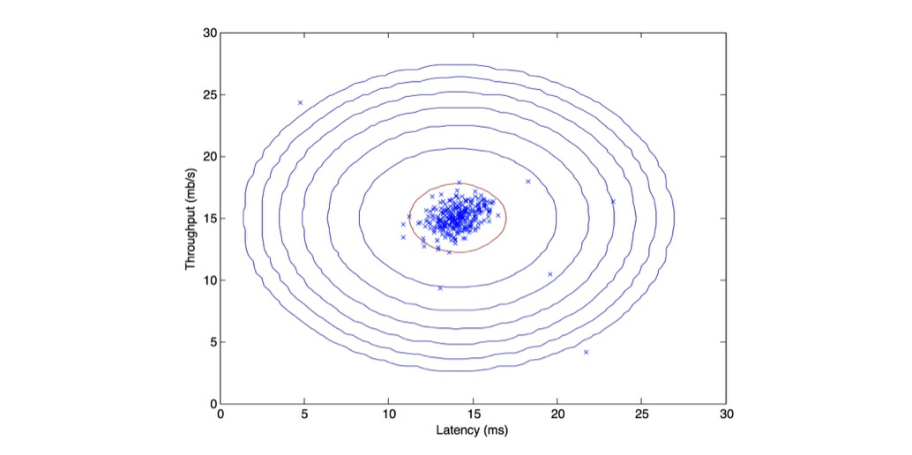
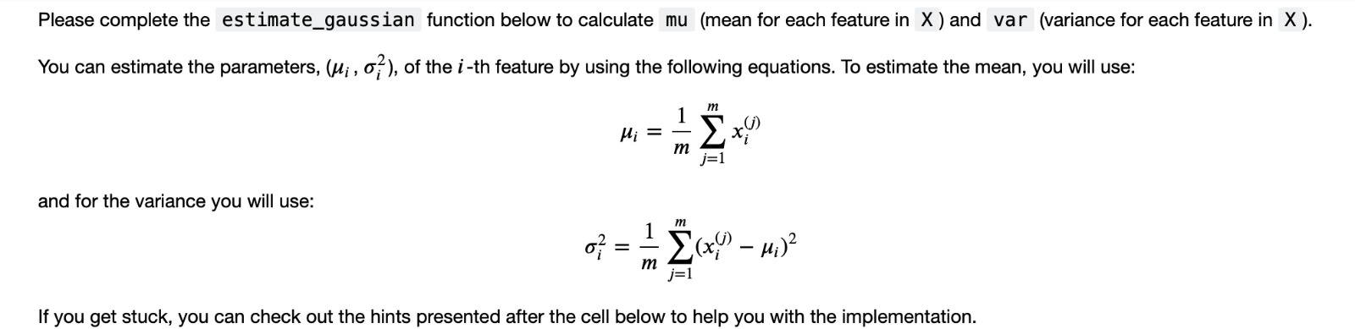
Anomalies detection

Slide 6
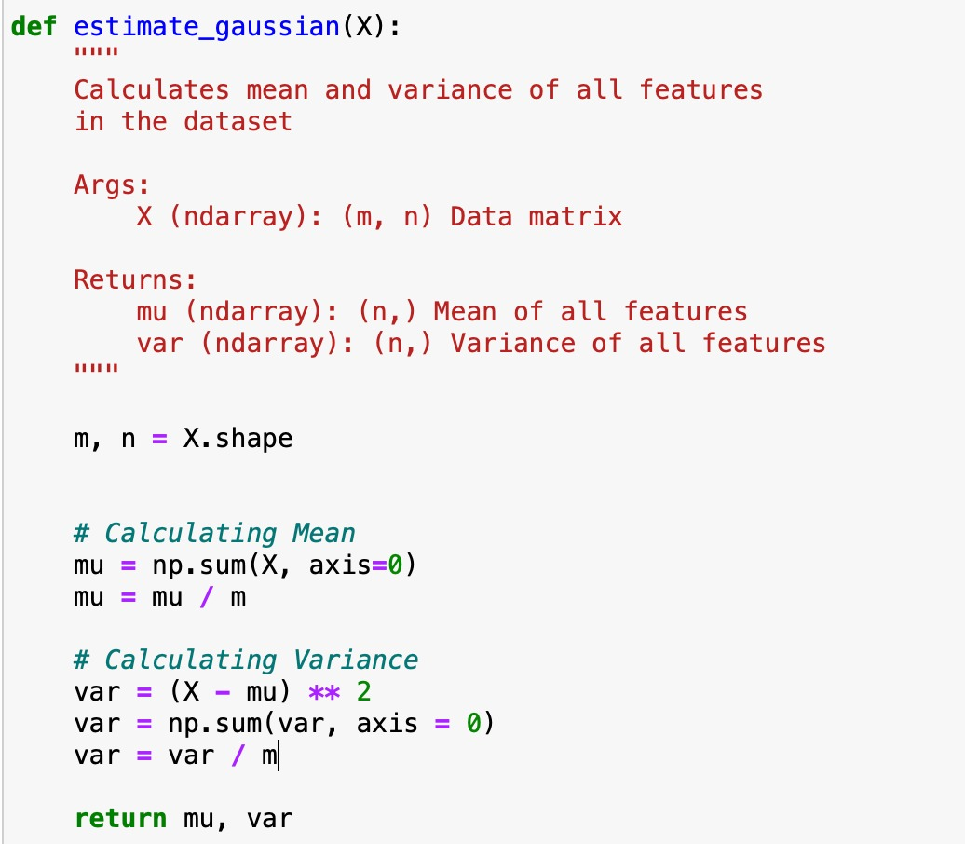
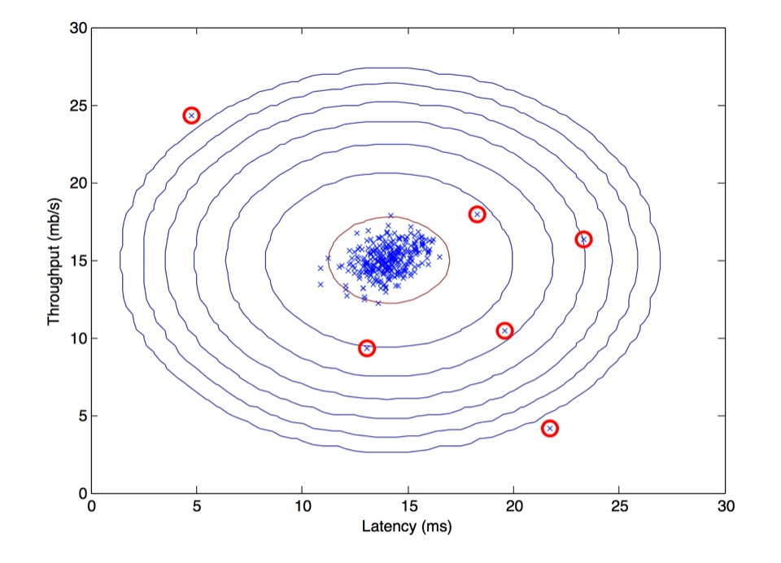
Al systems have been proven successful at detecting anomalies in transaction volume data. This time series process looks at expected data volumes based on historical patterns.
Upper and lower boundaries are also predicted based on volume variation. This system is then used to compare real-time transaction value to expected volume.
This real-time system allows network administrators to be notified when transactions start to spike above or fall below these boundaries so they can take action before an outage in service.

Slide 7

Conclusion
In conclusion, AI is transforming the banking industry in numerous ways, from improving customer service to enhancing security and risk management. As AI continues to evolve, we can expect to see even more innovative applications in the future.
However, it is important to note that AI is not a replacement for human expertise and judgment. Banks must ensure that they use AI responsibly and ethically, while continuing to prioritize customer needs and satisfaction.

Slide 8

THANK YOU

